Slide 1
STANFORD UNIVERSITY EE 102B Spring-2013
Lecture 26
Highlights - II
June 5, 2013

Slide 2
ASSIGNMENTS
Reading for this Lecture:
See readings on Course Schedule and previous lectures.
HW#09 is due by 5pm, Wednesday, June 5, in Packard 263. It is OPTIONAL to hand it in, but material on it will be covered on the final exam.
Please complete course evaluation on axess.

Slide 3
Office Hours for Course Staff – Come see us.
Ron Schafer: Mon. and Weds. 2:00-4:00 pm, Packard 211.
Dookun Park: Tues. 1:30 ~ 3:30 pm in Packard 107
Ruo Yu Gu (Roy): Mon. 4:00 ~ 6:00 pm in Packard 106
Review Session for Final Exam:

Slide 4
Final Exam
Covers entire course.
The exam will be held in 420-041, 8;30 am – 11:30 am.
You may use your textbook (either SP-First or Signals and Systems) and two sheets (both sides) of notes. No computers or other materials allowed.
Several people have conflicts that we will accommodate in Hewlett 102, 12:00 – 3:00pm. Please send email about your intention to take the exam at this time along with the reason for the conflict.
I will give you a table of all the DTFT and z-transform theorems and pairs. (Tables posted with this lecture.)

Slide 8
A Sampling Theorem for the DTFT

Slide 9
Comparison: DFT and DTFT
DFT
Inverse
DFT
DTFT
Inverse
DTFT

Slide 10
Sampling the DTFT
The DTFT of finite-length x[n]
The DFT is the sampled DTFT
DFT samples the DTFT at frequencies

Slide 11
Sample the DTFT and then reconstruct x[n] by inverse - I
Inverse DFT
of sampled
DTFT

Slide 12
Sample the DTFT and then reconstruct - II
Time-aliased
signal x[n]

Slide 13
Summary of DTFT Sampling Theorem
Sample DTFT to get DFT
Reconstruction by IDFT
Exact reconstruction if no overlap; i.e.,

Slide 14
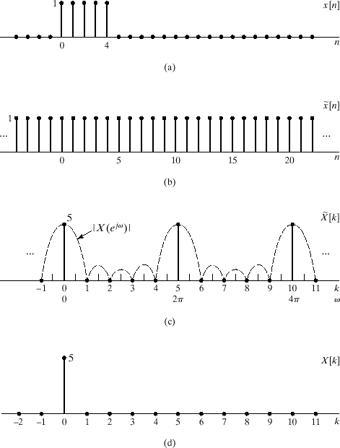

Slide 15
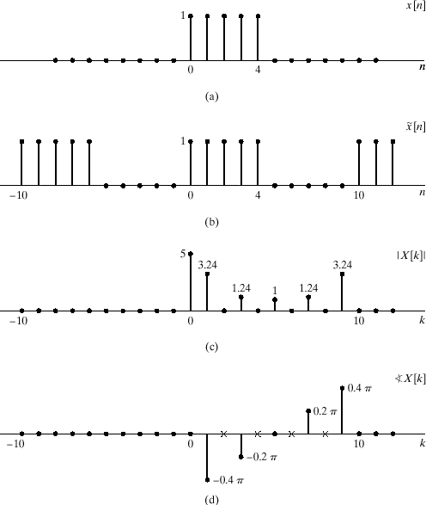

Slide 16
Using the DTFT Sampling Theorem for Time-domain Convolution

Slide 17
Convolution of Finite-Length Sequences
Let h[n] be of length P and x[n] of length L
y[n] also has finite length, L+P-1 samples

Slide 18
Frequency Domain
DTFT of a convolution
Sample the DTFT

Slide 19
Sampling the DTFT of a Convolution
Compute the sampled DTFT by computing the DFTs

Slide 20
Convolution Using the DFT
DFT
IDFT
DFT

Slide 21
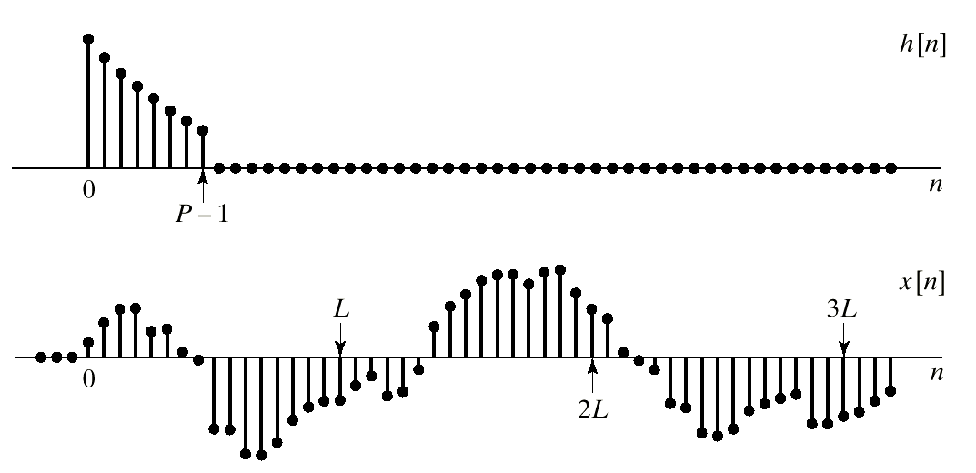
Block Convolution
Rectangular window

Slide 22
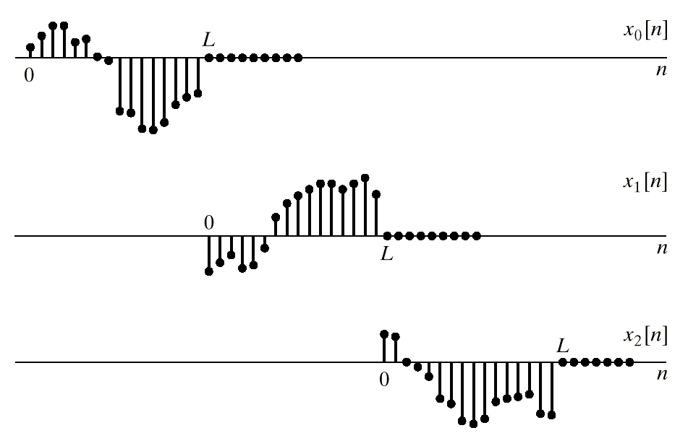
Segmenting the Input
Note: time origin is redefined
at the beginning of each block.

Slide 23
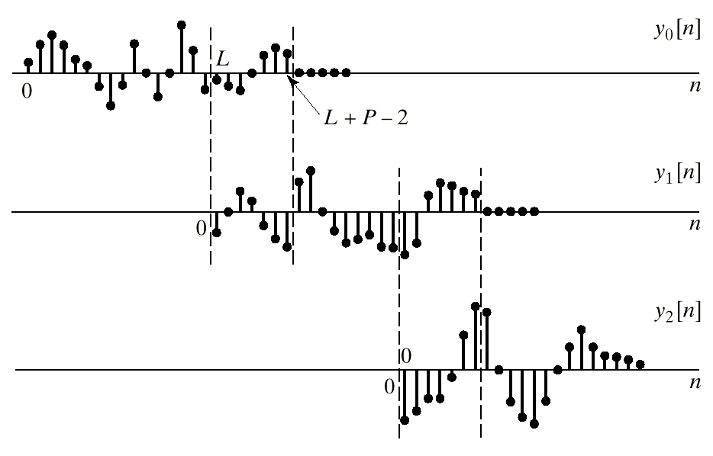
Putting the Output Pieces Together
overlap
overlap

Slide 24
Spectrum analysis of continuous-time signals

Slide 25
Spectrum Analysis of Continuous-Time Signals
Work out the details of the relationship between V[k]
and S(jω) to verify your understanding of all parts of
this important DSP system as well as how the parts
fit together to give an estimate of the spectrum.

Slide 26
Windowing

Slide 27
Multiplication in the Time-Domain
Multiplication in the time domain
Convolution in the frequency domain

Slide 28
Rectangular Window
Time window
DTFT of Window

Slide 29
Hann Window
Time window
DTFT of Window

Slide 30
Windowing a Sinusoid
40-point
Rectangular
Window
40-point
Hann
Window

Slide 33
the Short-Time spectrum The Spectrogram

Slide 34
Example 1
Consider the continuous-time time-varying sinusoidal signal

Slide 35

Example 1
Sample x(t) with sampling rate f_{s} = 2000.

Slide 36
Time-Dependent (Short Time) DFT
Definition: short-time DFT
Move the window in jumps of R samples
r^{th} windowed
“frame”

Slide 37
Illustration of Short-Time Analysis

Slide 38
Long-Term Spectrum of Example 1
5
Why do the spectrum components have
different widths (and heights?
0.5
2
2

Slide 39
Spectrogram for Example 1

Slide 40
Spectrogram Slices for Example 1

Slide 41
Example 2
The sampled signal is

Slide 42
Spectrogram for Example 2

Slide 43
Spectrogram Slices for Example 2

Slide 44
Time-Dependent Fourier synthesis using the dft

Slide 45
Reconstructing x[n] from X_{r} [n]
That is, we can recover the windowed signal. If the window is non-zero, we can divide it out to recover the signal x[rR+m] over the window interval. If the windows overlap, then we can get back all the original samples,

Slide 46
Overlap-Add Synthesis
Put the pieces back together by overlap-add
Perfect reconstruction if

Slide 47
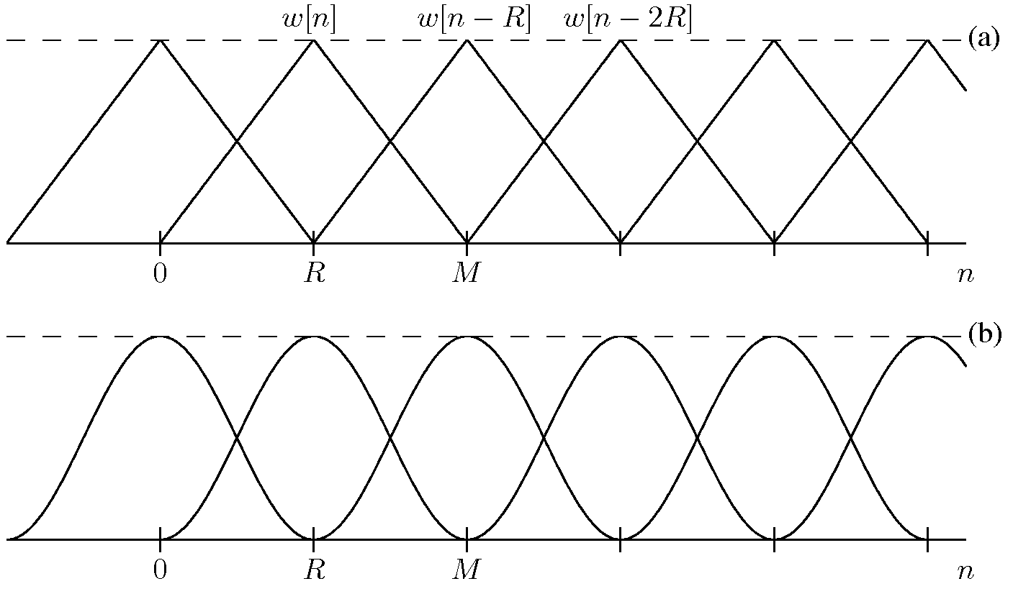
Windows for Perfect Reconstruction

Slide 48
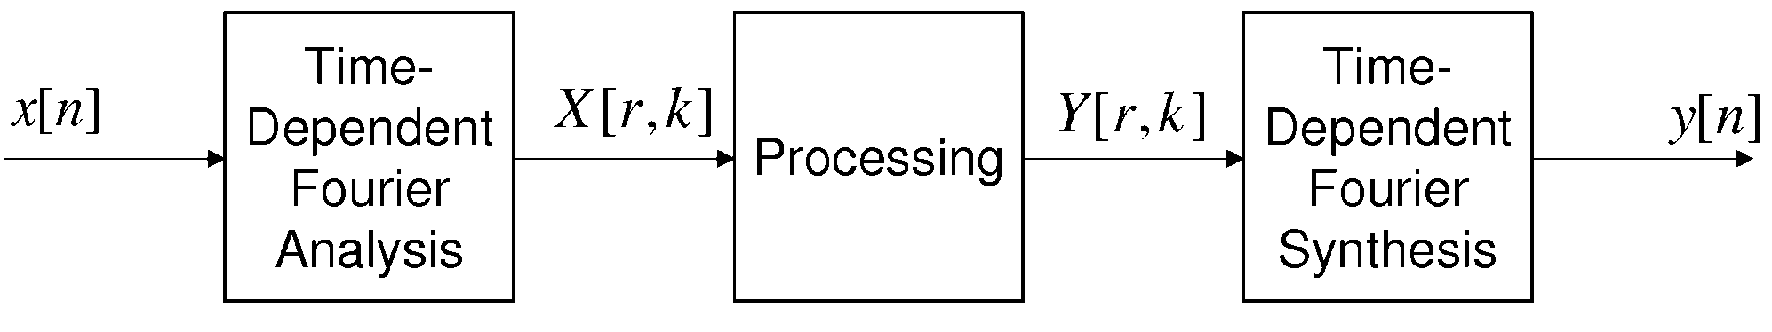
Time-Dependent Processing
For example, overlap-add filtering as used in filtering for acoustic noise reduction

Slide 49
Audio coding using the short-time dft

Slide 50
Audio Coding Using STFT
Short-time
Fourier
Analysis
Quantize
Short-time
Fourier
Synthesis
Quantize the time-dependent (short-time) Fourier transform
Introduce quantization noise in a way that can’t be heard; i.e., use knowledge of auditory masking to hide the noise
Transmit or store quantized STFT
Synthesize from quantized short-time transform
See Rabiner and Schafer, Theory and Applications of Digital Speech Processing, Prentice-Hall, 2011 or Spanias, et al, Audio Signal Processing and Coding, Wiley, 2006.

Slide 51
TDFT and Audibility Threshold

Slide 52
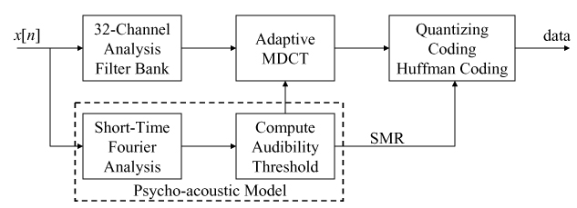
MP3 Audio Coder
Short-time Fourier transform for determining audibility threshold
Quantizer designed to put bits where they will do the most good
32-channel filter bank for frequency analysis

Slide 53
Filter Bank and Quantization
MP3 has 32 channel filter bank
Quantizer uses a 1024-point DFT as basis for estimating masking thresholds which control the quantizers.

Slide 54
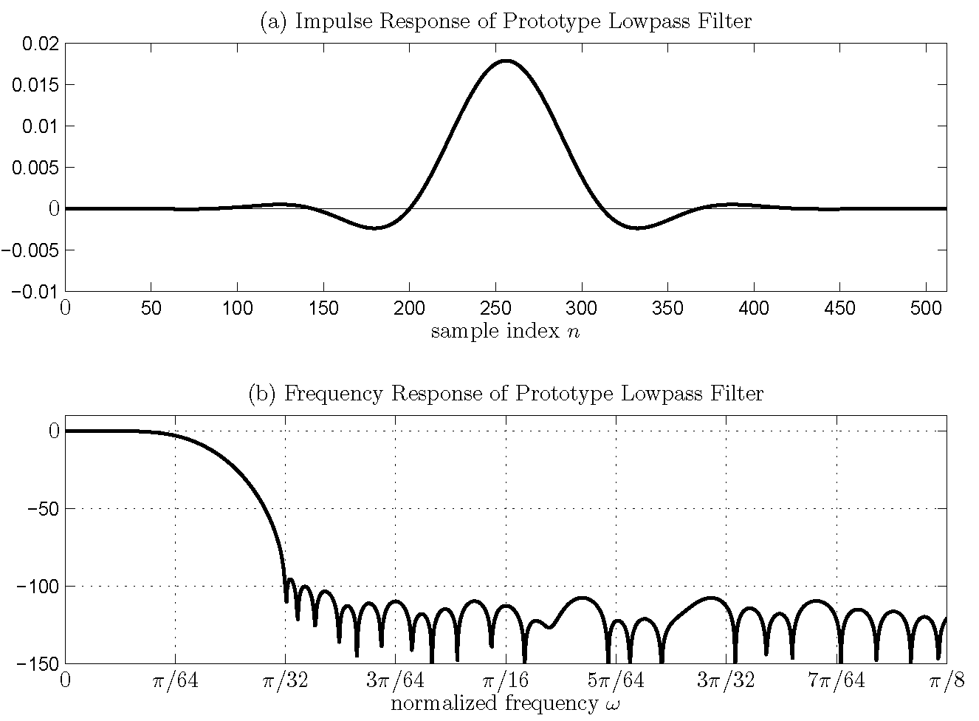
MPEG Window and Filter Impulse Response

Slide 55
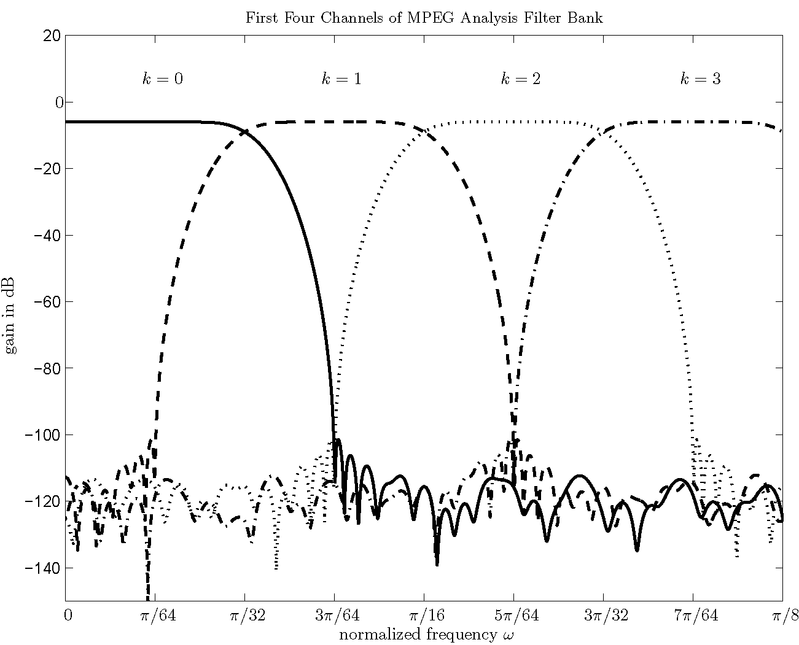
MPEG Filter Bank

Slide 56
Audibility Threshold for Filter Bank

Slide 57
Summary
Time-dependent Fourier analysis allows us to track changing properties of signals
Understanding the effect of windowing is important for understanding the TDFT
Perfect reconstruction is possible under some conditions.
The TDFT is a basis for processing signals
Filtering
Quantization and coding

Slide 58
The Z-Transform

Slide 59
The z-Transform
The z-Transform of a sequence is defined as
Since this is generally an infinite sum, we need to be concerned about “convergence”; i.e., is the sum finite? In general, the region of convergence (ROC) will depend upon z; e.g.,

Slide 60
Finite-Length Example:
Signal
z-Transform
Delayed signal y[n]=x[n-2]

Slide 61
Region of Convergence for z-Transform of an Infinite Sequence
The region of convergence (ROC) is the set of values such that,
can
“tame” a
growing
sequence

Slide 62
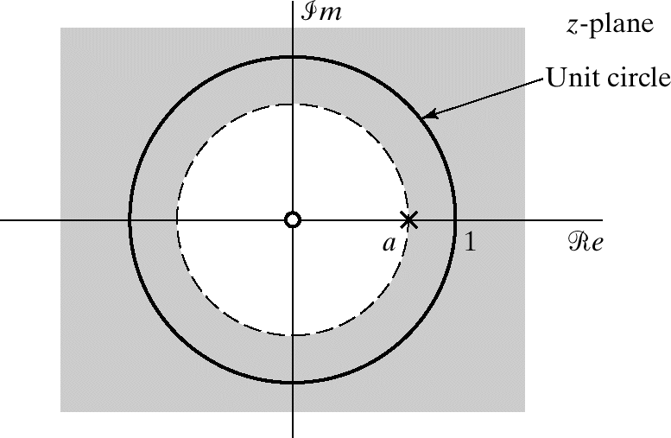
Right-Sided Exponential Signal
zero
pole

Slide 63
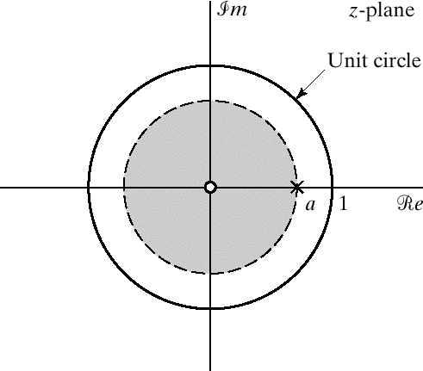
Left-Side Exponential Signal

Slide 64
Table of z-Transform Pairs
Impulse sequence
Right-sided exponential sequence
Left-sided exponential sequence

Slide 65
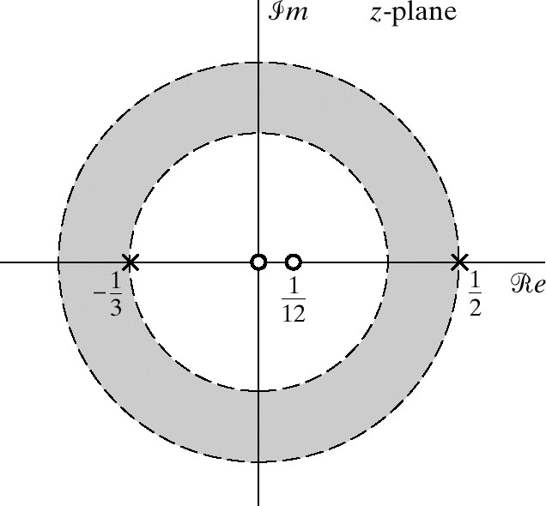
Two-Sided Exponential Signal

Slide 66
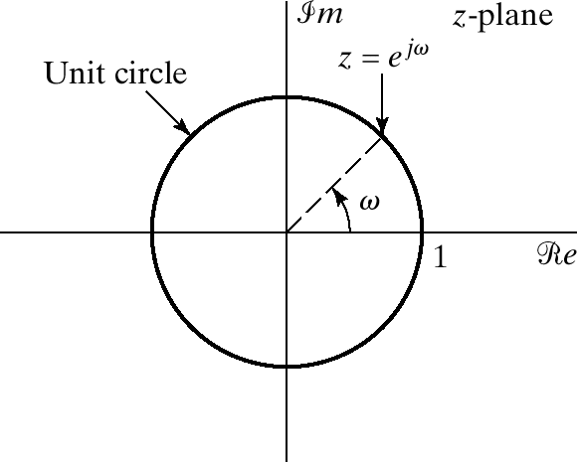
Relation to DTFT
The DTFT is equal to the z-transform evaluated on the unit circle:

Slide 67
LTI Systems and the z-Transform

Slide 68
Why is the z-transform so useful and important in DSP?
It’s all about algebra.
Convolution ➔ multiplication
Delay ➔ multiply by z⁻¹
Realizable systems described by ratios of polynomials H(z).
Polynomials are characterized by their roots ➔ poles and zeros.
Inverse by partial fraction expansion
Frequency response lives on unit circle of z-plane

Slide 69
Causal LTI Systems – 1
LTI
System
With initial
rest conditions

Slide 70
Causal LTI Systems – II Impulse response of DE

Slide 71
Frequency Response of a DE
ROC must
Contain the
Unit circle

Slide 72
Poles and Zeros and the Frequency Response

Slide 74
Classes of LTI Systems Based on Pole-Zero Locations
Stable and causal system
Minimum-phase systems H_{min}(z)
Allpass systems H_{ap}(z)
Causal and stable inverse system for H(z)

Slide 75
Allpass Systems
Allpass systems have constant gain with varying phase shift.
H_{ap}(z) composed of factors of the form:
That is, a pole at z = a and zero at z = a⁻¹

Slide 76
General Representation of Systems - I
Any system with no zeros on the unit circle can be represented as
Example

Slide 77
General Representation of Systems - II
If the system has zeros on the unit circle it can be represented as

Slide 78
Third-Order Elliptic Filter Example

Slide 80
Parallel form (partial fraction expansion)

Slide 81
Steady-state response to a Complex Exponential

Slide 82
Frequency Response and Complex Exponential Signals
What if the complex exponential is “suddenly applied”?
LTI
System

Slide 83
Steady-State Response of IIR Systems - I
Suddenly applied complex exponential
z-transform of output

Slide 84
Steady-State Response of IIR Systems - II
Make a partial fraction expansion

Slide 85
Steady-State Response of IIR Systems - III
Partial fraction expansion
Inverse z-transform

Slide 86
Steady-State Response – IIR

